Slide 1


Internship at the Institute for Environmental Professionals
Geoffrey Kie
Sophomore at NAU
Double major in Applied Indigenous Studies and Journalism

Slide 2
The Big Picture…
Tar Creek is an area in the Northeast Oklahoma region that has been polluted by a century of mining for Zinc and Lead. The different processes that have been used to mine were not the most eco-friendly.
Mine tailings have oxidized the water to an orange color
Tailings cover the land that look like giant mounds that are not part of the natural landscape
Tailings are also polluting the air and soil around the area.

Slide 3
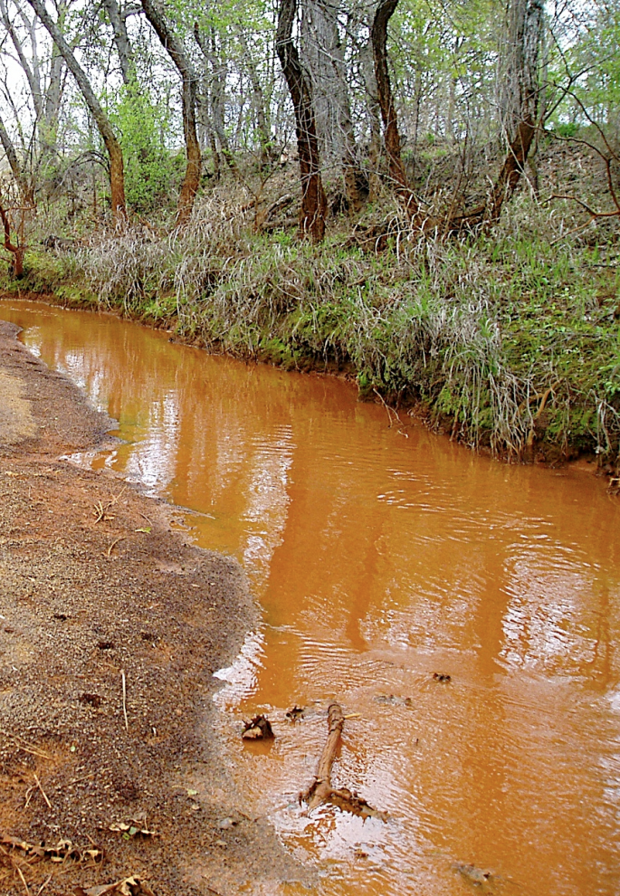
Why Care?
Information provided by EPA and Dr. Snider among with others, who did the social science of gathering data from individuals.
Indigenous Environmental Justice
Four forms of justice
Procedural
Distributive
Social
Corrective

Slide 4
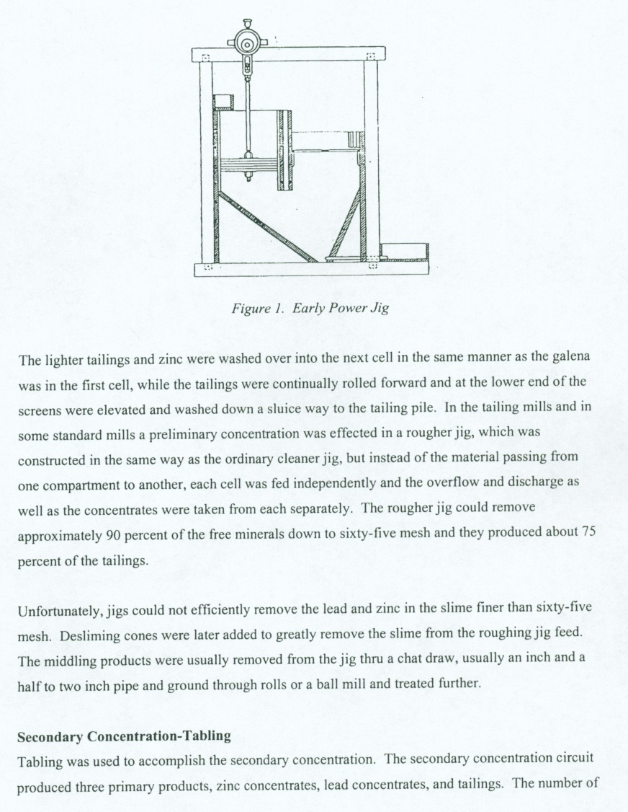
Procedural Justice
Is the process of having participation from all groups involved
Having all records and forms interpreted so groups can understand
Practically any group involved be apart of the decision making process.

Slide 5
Distributive Justice
Is the distribution of all the resources agreed upon which can include
Water
Land
Money
Power

Slide 6
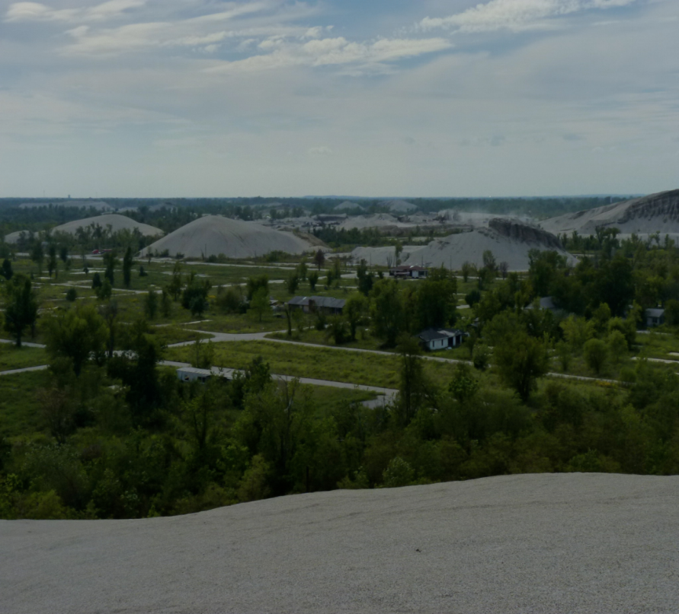
Social Justice
Is the equal treatment of the people and their living conditions.
Living conditions may include but not limited to homes, water, food.
Which are all capabilities to live a “full life” which is the main goal for Social Justice

Slide 7
Corrective Justice
Is the hardest form of justice to pursue.
Finding who is completely liable for any injustices caused by an entity
The people have the right to charge the company liable and can ask for justice in terms of:
Money
Land Remediation
Resources

Slide 8
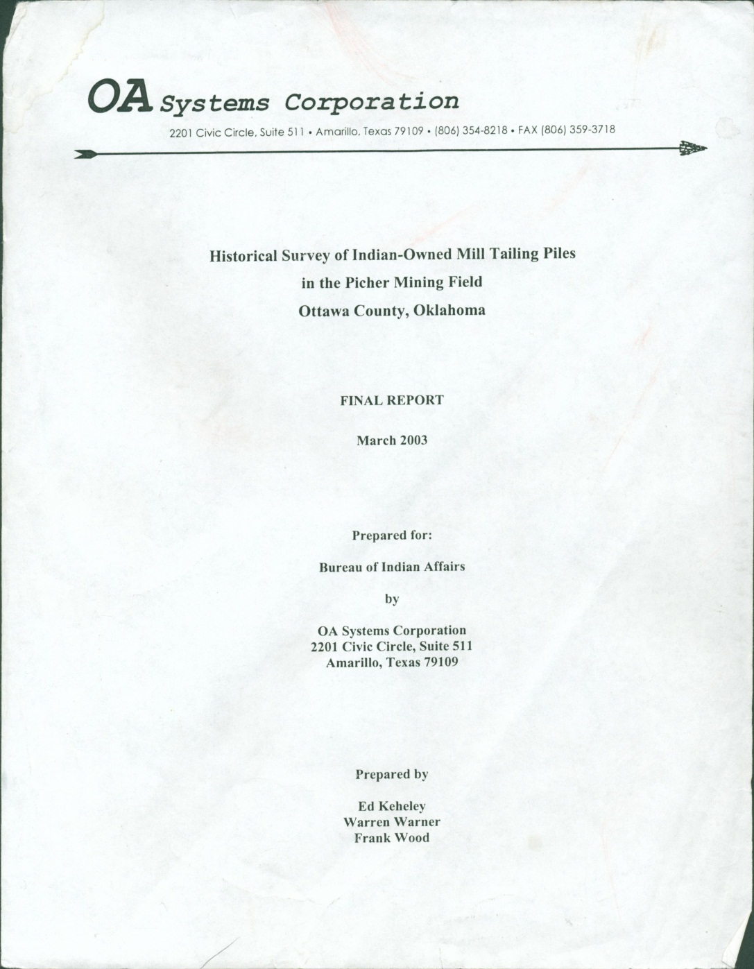
Analysis
My part is organizing the data, learning the history of the area, everything that affects the region and how to remediate.
Also organizing emails of who was contacted by whom as well as the dates in which it happened.
The downstream tribe known as the Quawpaw is the group that is seeking justice along with other communities

Slide 9
To Conclude…
There are a lot injustices that are happening in the world, even the U.S. on a daily basis.
Knowing the proper process of how to deal with these kinds of cases and most importantly trying to prevent them from happening.
The future work would be to continue in pushing cases like this further until the impacted people are no longer afflicted.

Slide 10


Acknowledgments
Karen Jarratt-Snider
Institute for Tribal Environmental Professionals
Kathleen Stigmon
Nadine Barlow

